Slide 1
The Obedient Ray
Penguin Book of Curious and Interesting Puzzles No. 378

Slide 2
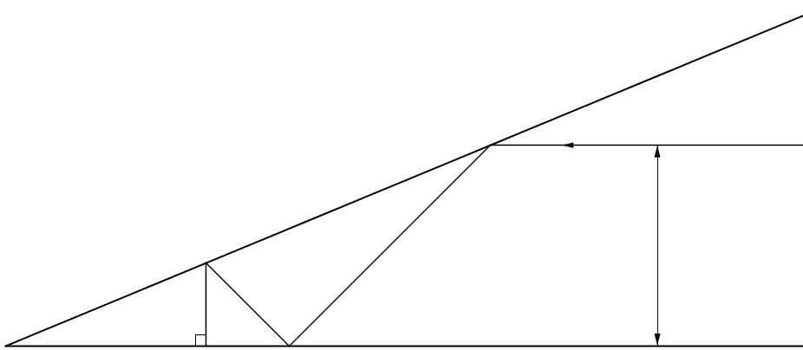





The Obedient Ray
Two mirrors are fixed at O and a ray of light enters, bounces around and goes out on the same path.
Given distance OX, what is the height of the ray above the base mirror (to which it is parallel)?
What is the angle between the mirrors?
$$h$$
$$α$$
$$O$$
$$a$$
$$X$$

Slide 3









The Obedient Ray
Considering the angle, $α$ , first:
$90°+4α=180°$
$α=22.5°$
$$α$$
$$α$$
$$90°$$
$$2α$$
normal
$$α$$
$$α$$
$$2α$$
$$2α$$
$$α$$
$$O$$
$$a$$
$$X$$

Slide 4



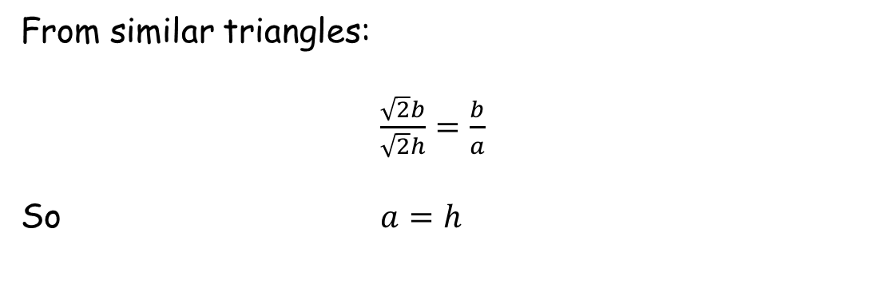









The Obedient Ray
From similar triangles:
$\frac{\sqrt{2}b}{\sqrt{2}h}=\frac{b}{a}$
So $a=h$
$$α$$
$$α$$
$$45°$$
$$\sqrt{2}h$$
$$h$$
$$h$$
$$45°$$
$$\sqrt{2}b$$
$$b$$
$$α$$
$$45°$$
$$90°$$
$$45°$$
$$O$$
$$a$$
$$X$$
$$b$$
$$h$$

Slide 5


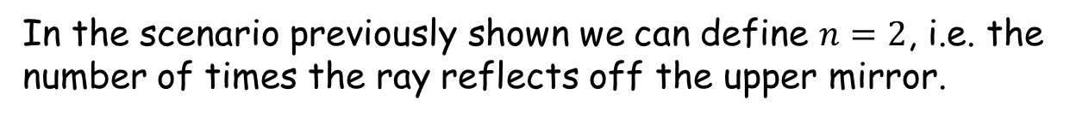







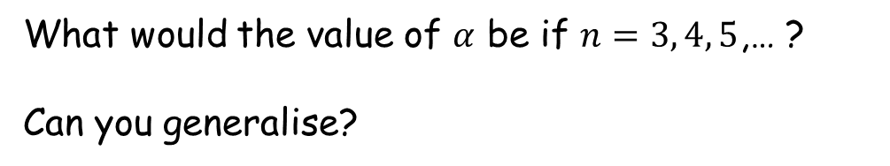

The Obedient Ray
In the scenario previously shown we can define $n=2$, i.e. the number of times the ray reflects off the upper mirror.
What would the value of $α$ be if $n=3, 4, 5$,… ?
Can you generalise?
$$90°−5α$$
$$90°−3α$$
$$90°−α$$
$$α$$
$$O$$
$$6α$$
$$2α$$
$$4α$$
$$10α$$
$$8α$$

Slide 6

The Obedient Ray
For $n=1$ , $90°−α$ is equal to $α$
$$90°−5α$$
$$90°−3α$$
$$90°−α$$
$$α$$
$$O$$

Slide 7

The Obedient Ray
For $n=1$ , $90°−α$ is equal to $α$
For $n=2$ , $90°−3α$ is equal to $α$
$$90°−5α$$
$$90°−3α$$
$$90°−α$$
$$α$$
$$O$$

Slide 8
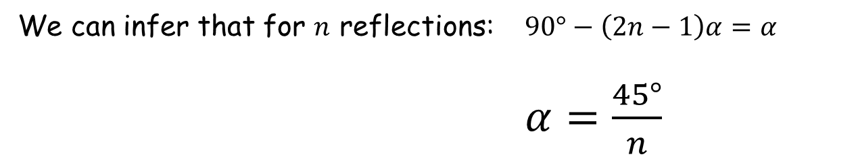

The Obedient Ray
For $n=1$ , $90°−α$ is equal to $α$
For $n=2$ , $90°−3α$ is equal to $α$
For $n=3$ , $90°−5α$ is equal to $α$
$$90°−5α$$
$$90°−3α$$
$$90°−α$$
$$α$$
$$O$$
We can infer that for $n$ reflections: $90°−\left(2n−1\right)α=α$
$α=\frac{45°}{n}$

Slide 10
RESOURCES

Slide 11



The Obedient Ray
SIC_42
Two mirrors are fixed at O and a ray of light enters, bounces around and goes out on the same path.
Given distance OX, what is the height of the ray above the base mirror (to which it is parallel)?
What is the angle between the mirrors?
$$h$$
$$α$$
$$O$$
$$10cm$$
$$X$$

Slide 12
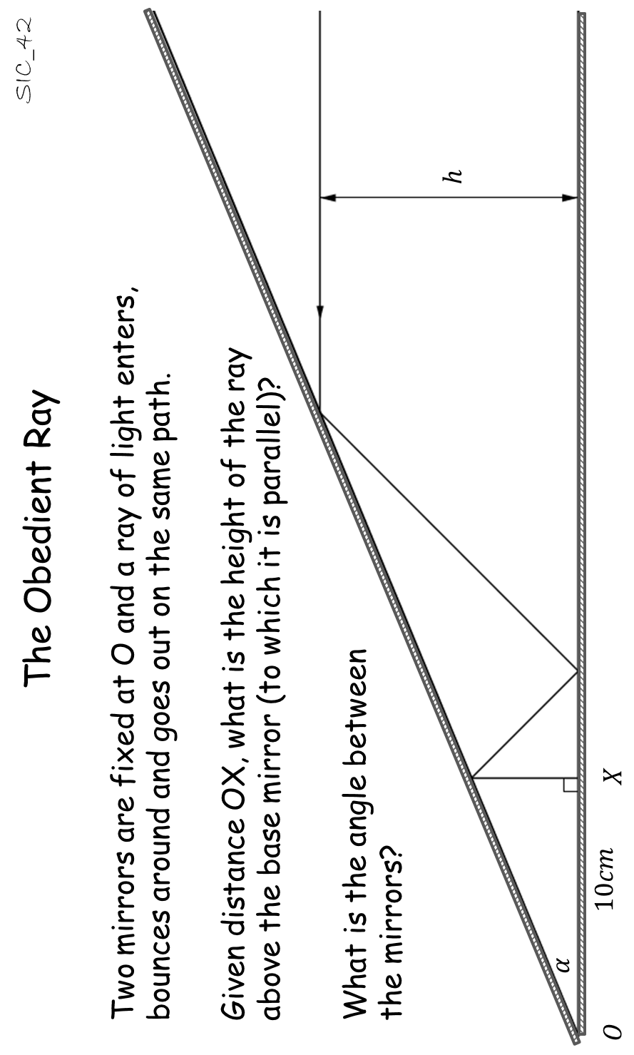


Slide 13



Slide 14



Slide 15



Slide 16



Slide 17



